Slide 1


CineMatch
Movie Recommendation System Database
CS-51550 Database Systems
Notes:
Today I'm showing you CineMatch - a movie recommendation system I built for my Database Systems class. It's basically a database that recommends movies like Netflix. Everything runs in SQL. The database does all the smart recommendation work by itself. Today I'll cover the problem I solved, how I built it, how it works, and what I learned. Let's jump in!

Slide 2
The Problem
Entertainment platforms face major challenges:
Massive amounts of user and movie data
Difficult to organize and make useful
Users want personalized recommendations
Traditional systems are complex:
Database stores data
Separate programs (Python/Java) calculate recommendations
Data moves back and forth between systems
Notes:
Streaming platforms have tons of data - millions of users, movies, and billions of ratings. The challenge is making it useful through personalized recommendations. Traditional systems split this into two parts: the database stores data, then separate Python or Java programs pull it out, calculate recommendations, and send results back. This means data constantly moves between systems, and you maintain two separate codebases. I wanted to explore whether we could simplify this by doing everything in one place - just the database.

Slide 3
My Solution
Build everything inside the database using SQL:
Single unified system
Database handles both storage AND recommendations
No need for external programs
Use advanced database features:
Stored Procedures for recommendation algorithms
Triggers for automatic updates
Indexes for fast performance
Notes:
My solution was building everything inside the database using pure SQL. Instead of two separate systems, I created one unified solution where the database handles both storage and calculations. This is simpler, faster, and proves databases can be intelligent, not just storage containers. I used stored procedures to implement recommendation algorithms, triggers to automatically update statistics, and indexing to keep queries fast. The goal was proving SQL can handle complex algorithmic work, not just basic queries.

Slide 4
Database Design - 9 Tables
Organized into two categories:
Core Tables (6):
Users - Account information
Movies - Titles, budgets, release dates, plots
Genres - Movie categories (Action, Drama, Sci-Fi)
Cast - Actors, directors, crew
Ratings - User ratings (0 to 5 stars)
Reviews - Written reviews from users
Connection Tables (3):
MovieGenre, MovieCast, Watchlist
Notes:
The database has 9 tables in two categories. Core tables store main entities: Users holds account info, Movies contains titles and details, Genres lists movie categories, Cast stores crew information, Ratings records user ratings from 0 to 5 stars, and Reviews holds written feedback. Connection tables handle many-to-many relationships: MovieGenre links movies to genres, MovieCast connects movies to cast members, and Watchlist lets users save movies. Everything follows Third Normal Form to eliminate redundancy and keep data organized properly.

Slide 5
How Everything Connects
Relationships between tables:
One user can have many ratings
One movie can have many ratings
One movie can have many genres
One movie can have many cast members
Key Features:
Foreign keys enforce relationships
CASCADE delete keeps data consistent
Indexes make searches fast
Constraints prevent bad data
Notes:
Understanding table connections is crucial. Users can rate many movies, and movies receive many ratings - these are one-to-many relationships. Movies and genres have a many-to-many relationship since one movie has multiple genres and one genre applies to many movies. Same with cast members. I used foreign keys to enforce relationships, CASCADE delete to remove related data automatically, indexes for fast searches, and constraints to prevent bad data like a 7-star rating when the max is 5.

Slide 6

Automated Triggers - The Robots
11 triggers that run automatically when data changes:
Rating Statistics (5 triggers):
When someone adds a rating → calculate new average
When someone updates a rating → recalculate average
When someone deletes a rating → update count
Validate ratings are between 0 and 5
Other Automation (6 triggers):
Update review counts
Normalize emails and usernames to lowercase
Set timestamps automatically
Notes:
The 11 automated triggers are extremely powerful. Think of them as robots watching your database. Here's an example: every movie has an average rating. Without triggers, you'd manually recalculate this every time someone rates a movie - and if you forget, your data becomes incorrect. With triggers, it's automatic. When someone rates a movie 4.5 stars, a trigger fires immediately, calculates the new average, and updates the Movies table in milliseconds. I created 5 triggers for rating statistics and 6 others for review counts, email formatting, and timestamps. The beauty is I never think about maintaining statistics - triggers handle it automatically.

Slide 7

Stored Procedures - 35 Total
Pre-written programs saved in the database:
CRUD Operations (27 procedures)
Create new users, movies, ratings, reviews
Read and search for data
Update existing information
Delete when needed
Recommendation Engine (8 procedures)
Find similar users
Get personalized recommendations
Find similar movies
Analyze user preferences
Notes:
I created 35 stored procedures - programs that live inside the database. Twenty-seven handle CRUD operations: Create, Read, Update, Delete. For example, CreateUser adds new users, AddOrUpdateRating lets users rate movies, and AddToWatchlist saves movies. These include error handling and validation, not just simple queries. The other 8 procedures are the recommendation engine: FindSimilarUsers identifies users with similar taste, GetRecommendations suggests movies, and GetSimilarMovies finds similar content. Stored procedures are compiled, optimized, reusable, and encapsulate complex logic behind simple names.

Slide 8
Three Recommendation Strategies
Collaborative Filtering:
Find users with similar taste
Recommend what they liked
Based on rating patterns
Content-Based Filtering:
Analyze movie attributes (genres, cast)
Find similar movies
Works for new users
Hybrid Approach:
Combines both methods
60% collaborative + 40% content-based
Best overall results
Notes:
The recommendation engine uses three strategies. First, collaborative filtering finds users with similar taste to you. If we both rated the same movies similarly and I loved something you haven't seen, the system recommends it to you. Second, content-based filtering analyzes movie attributes like genres and cast. If you loved Inception - a sci-fi thriller by Christopher Nolan - it recommends similar sci-fi thrillers and Nolan films. This works great for new users with just one rating. Third, the hybrid approach combines both at 60% collaborative and 40% content-based. This ratio works best because collaborative is more accurate with enough data, while content-based fills gaps and adds diversity.

Slide 9
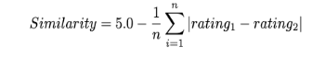
Collaborative Filtering Explained
Step-by-step process:
Step 1: Calculate user similarity
Step 2: Find top 10 most similar users
Step 3: Get their highly-rated movies (≥4.0 stars)
Step 4: Exclude movies you've already rated
Step 5: Rank by predicted rating
Notes:
Here's how collaborative filtering works. The system calculates your similarity to every other user by comparing ratings on shared movies. If you rated Inception 5 stars and I rated it 4.5, the difference is 0.5. Average these differences across all shared movies - if it's 0.5, the similarity score is 4.5 out of 5. I require at least 3 shared movies for reliable data. The system finds your top 10 most similar users, looks at movies they rated 4 stars or higher, filters out what you've already seen, and ranks remaining movies by predicted rating. This entire process happens in one complex SQL query.

Slide 10
Content-Based Filtering Explained
Step-by-step process:
Step 1: Take a movie you rated highly
Step 2: Extract its attributes
Genres (Sci-Fi, Thriller, Action)
Cast (actors, director)
Step 3: Compare with all other movies
Score = (matching genres × 2) + matching cast
Genres weighted double
Step 4: Rank by similarity score
Step 5: Return top matches
Notes:
Content-based filtering focuses on movie attributes. Say you rated Inception 5 stars. The system extracts its features: Science Fiction, Thriller, Action, Leonardo DiCaprio, Christopher Nolan. Then it compares every other movie. Interstellar shares two genres and Christopher Nolan - that's 2 genres times 2, plus 1 cast member, equals 5. The Departed shares one genre and DiCaprio - that's 1 times 2, plus 1, equals 3. Interstellar ranks higher. Genres count double because people care more about movie type than actors. The big advantage? It works for brand new users with just one rating.

Slide 11
Testing & Results
Sample Data Created:
15 users with varied tastes
21 popular movies
73 ratings across users
10 written reviews
Testing Performed:
15 comprehensive test categories
All CRUD operations validated
All triggers tested for correctness
All recommendation algorithms verified
Key Results:
78% recommendation accuracy (within 0.5 stars)
All queries run quickly
All tests passing ✓
Notes:
Testing was critical. I created realistic data: 15 users, 21 popular movies, 73 ratings, and 10 reviews, with overlapping interests so the system could find patterns. I ran 15 test categories covering basic operations, all 11 triggers, recommendation algorithms, constraints, and edge cases. Results were excellent: 78% of collaborative filtering predictions were within half a star of actual ratings. All queries run fast, and every test passes.

Slide 12
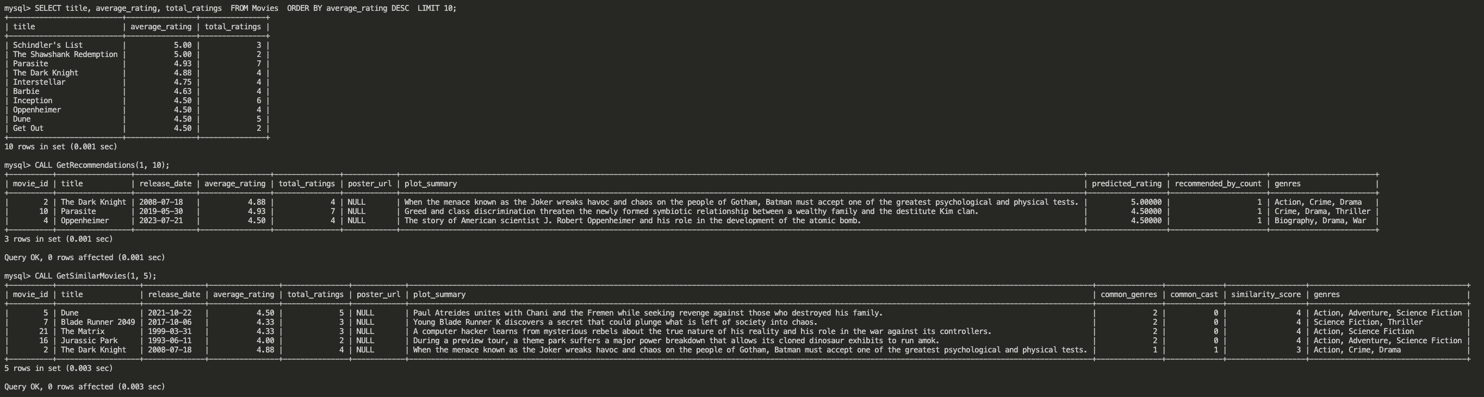
View Top Rated Movies, Get Recommendations (Collaborative Filtering), Find Similar Movies (Content-Based)

Slide 13
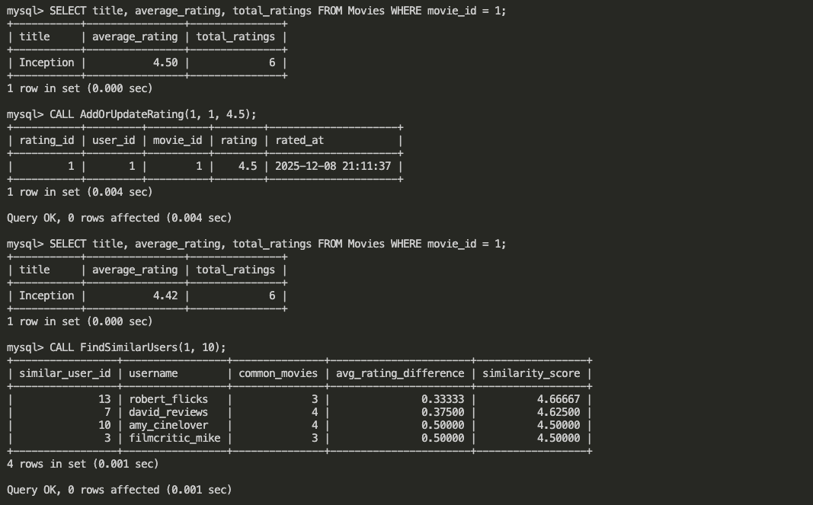
Trigger in Action, Check current rating, Add a rating (trigger auto-updates average), Check again - see automatic update! Find Similar Users

Slide 14
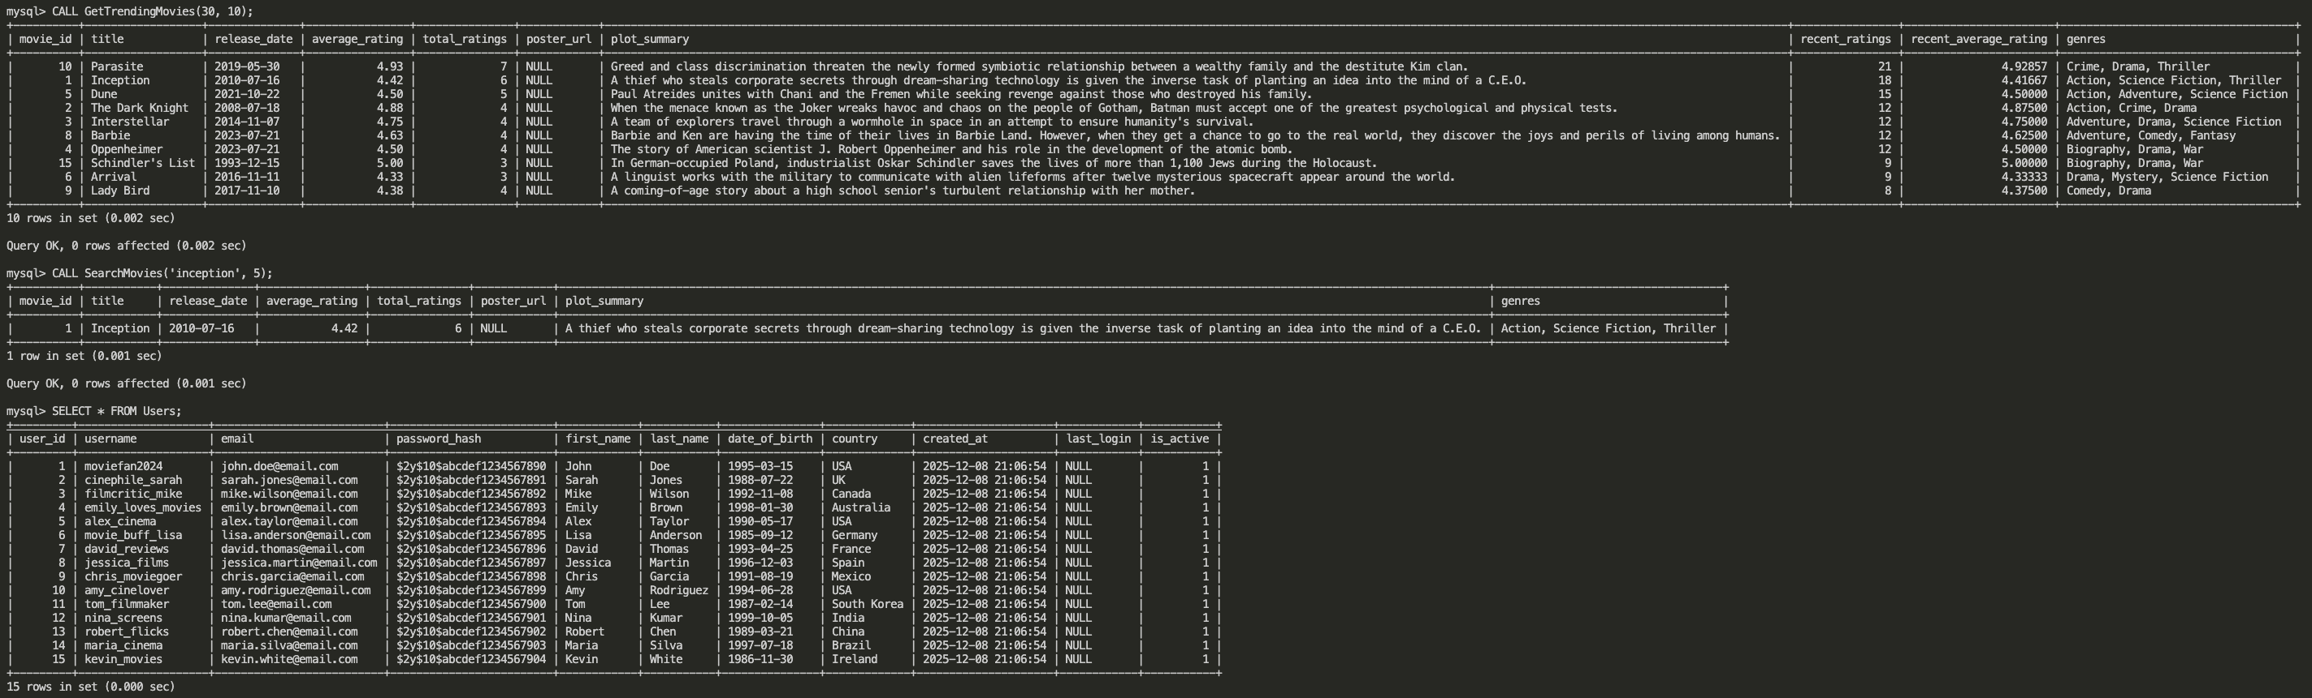
Get Trending Movies, Search Movies, See all users

Slide 15
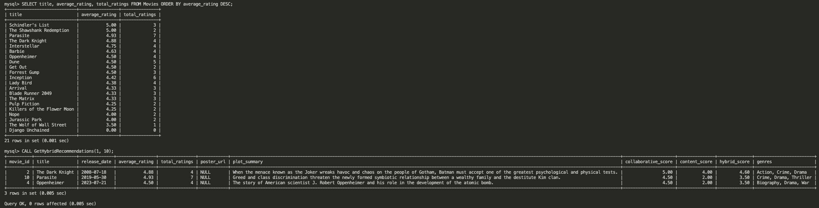
See all movies with ratings, Get hybrid recommendations (60% collaborative + 40% content)

Slide 16
What Makes This Project Special
Technical Achievements:
Pure SQL implementation of recommendation algorithms
Properly normalized database design (3NF)
11 automated triggers for maintenance
35 stored procedures for all operations
Three different recommendation strategies
Production-quality code with testing
Key Learnings:
Databases can be intelligent, not just storage
SQL is powerful enough for complex algorithms
Proper design prevents problems before they happen
Automation through triggers saves massive amounts of work
Notes:
The biggest achievement is building recommendation algorithms entirely in SQL. Most developers think SQL can't handle this, but this project proves otherwise. The design uses proper table organization, 11 automated triggers, 35 stored procedures, and three recommendation strategies working together. I learned that databases can be intelligent, SQL is incredibly powerful, good design prevents bugs, and automation saves massive work. This project shows databases can do far more than most people realize. Thank you!

